Slide 2
Capital Street Projects

Slide 3
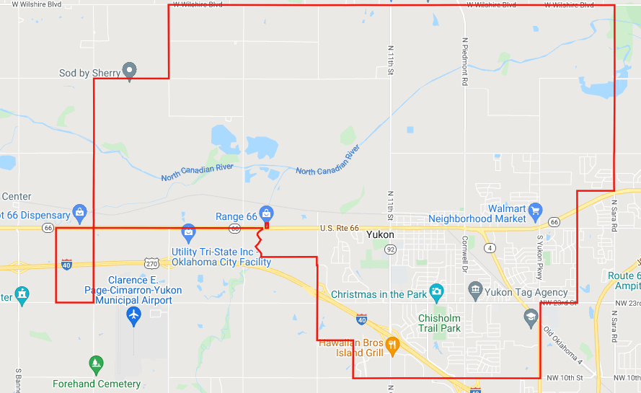
Corporate City limits

Slide 4
Potential Street Capital Projects
• 380 Lane Miles of Roads
– 28 Miles of Chip & Seal
▪ 70% needs to be repaired at an approximate cost of $7 million
− 55 Miles of Asphalt
▪ 60% needs to be repaired at an approximate cost of
$17.6 million
− 297 Miles of Concrete
▪ 30% needs to be repaired at an approximate cost of $37.4 million

Slide 5
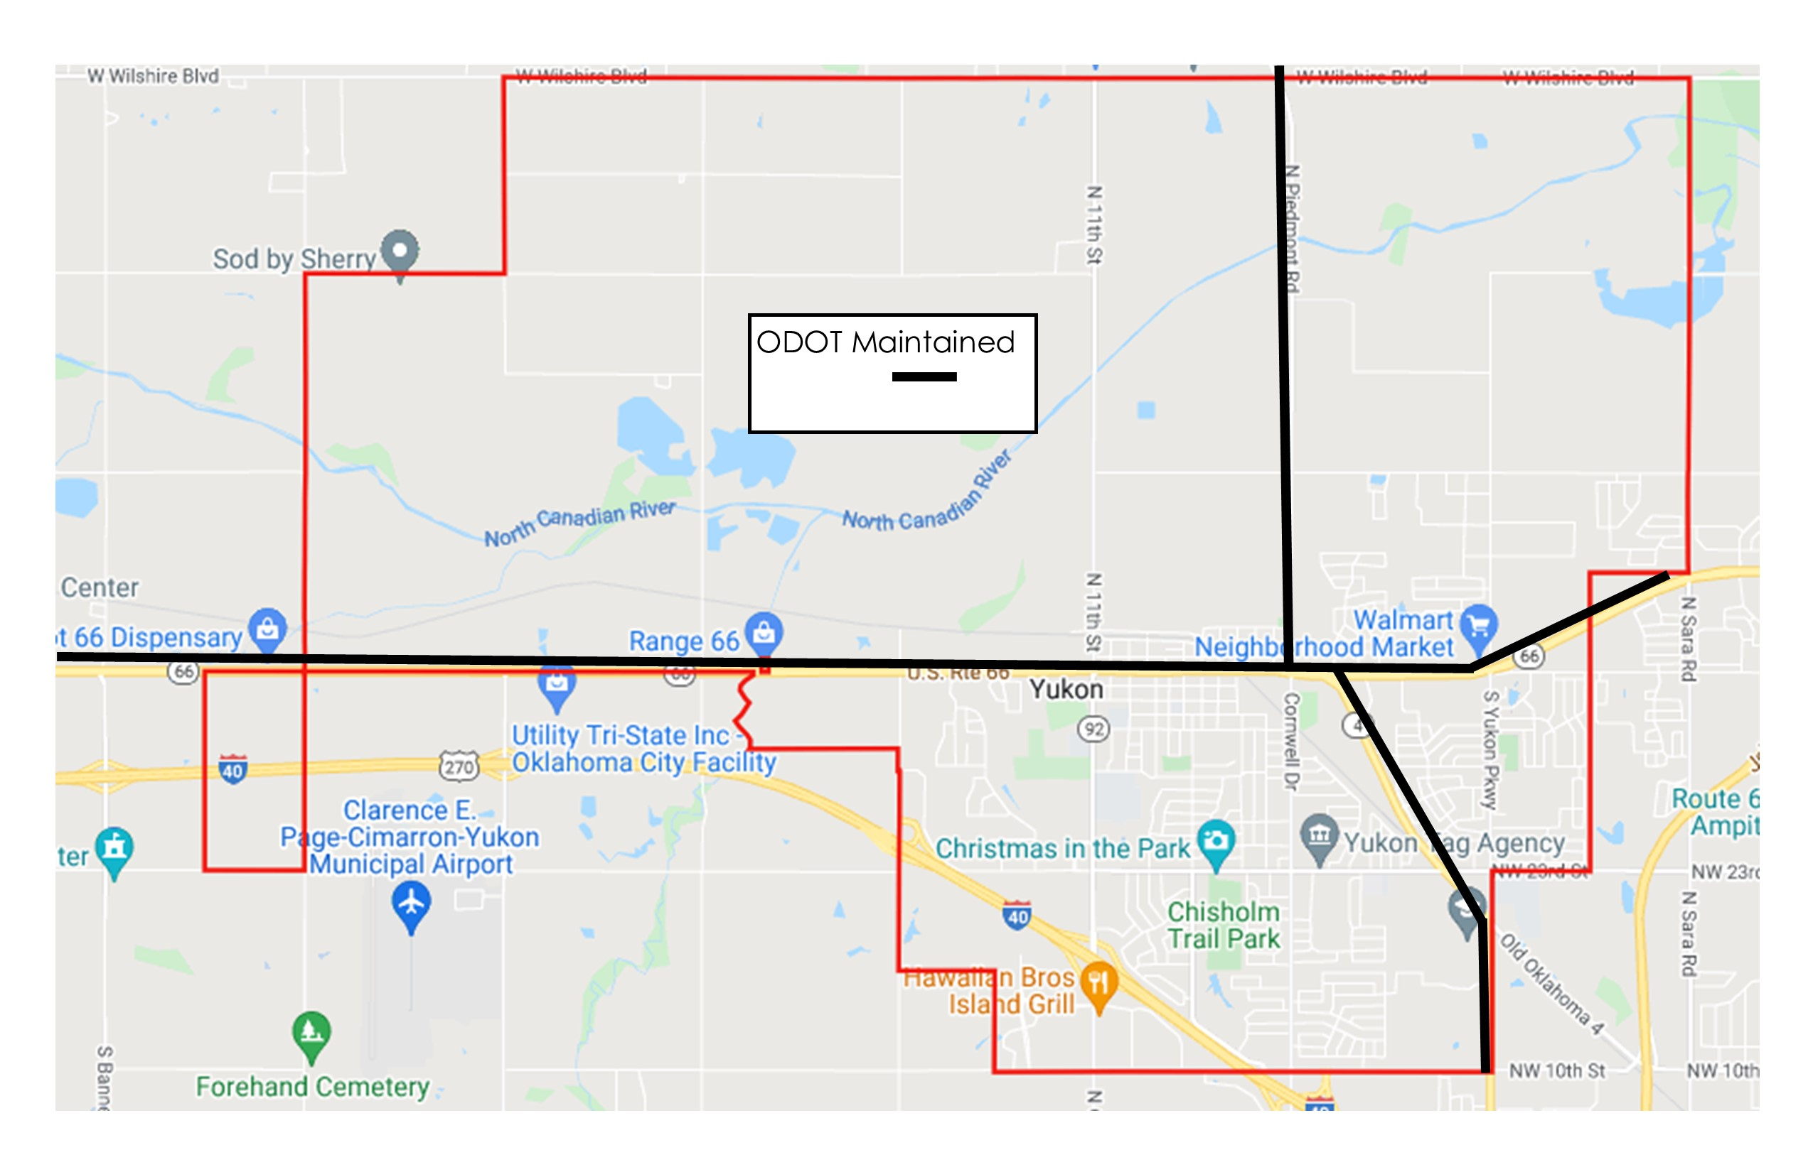
ODOT Maintained Roads

Slide 6
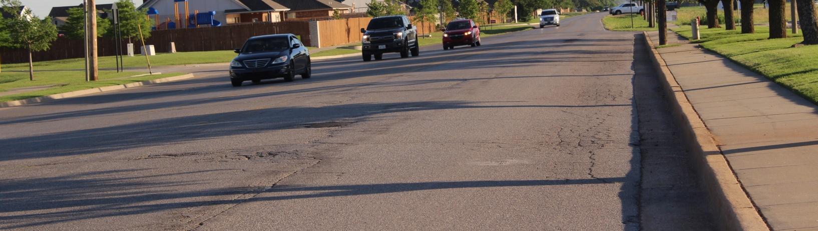
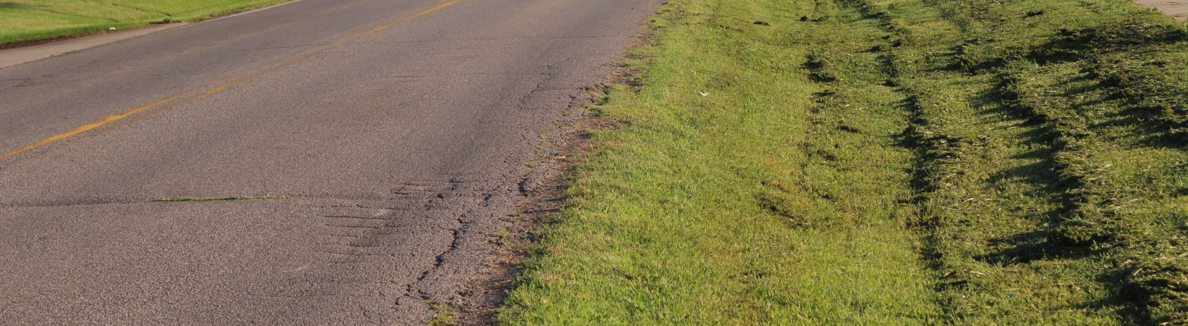
Yukon Parkway

Slide 7
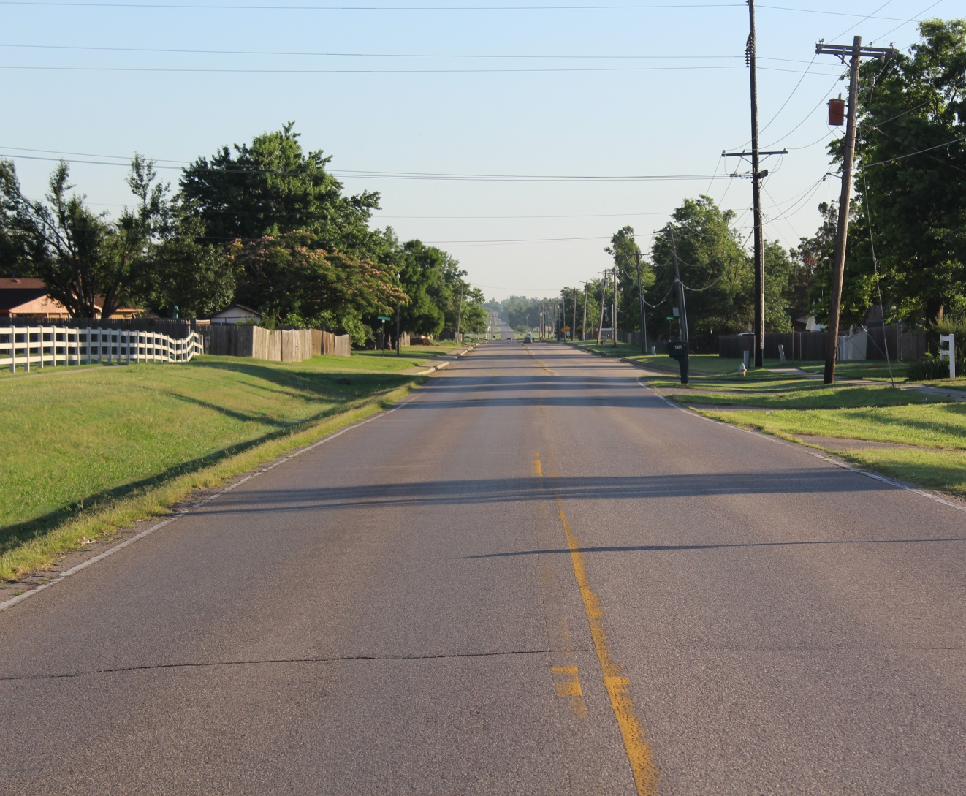
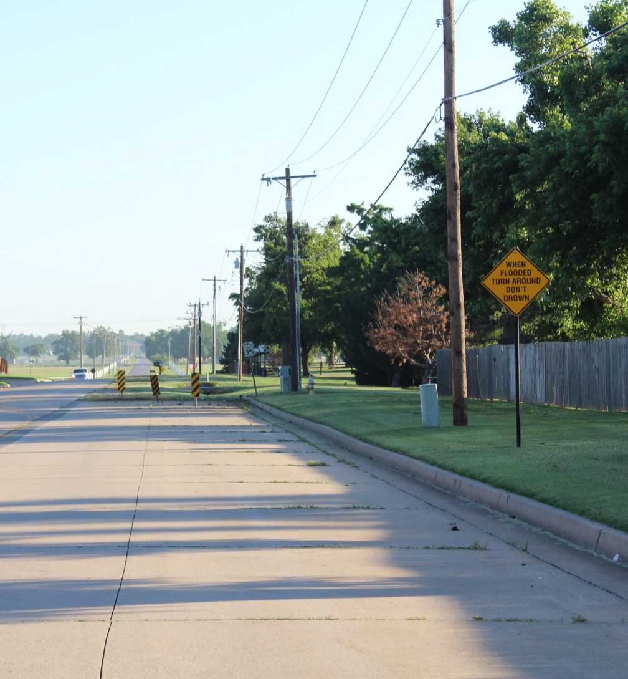
Yukon Parkway

Slide 8
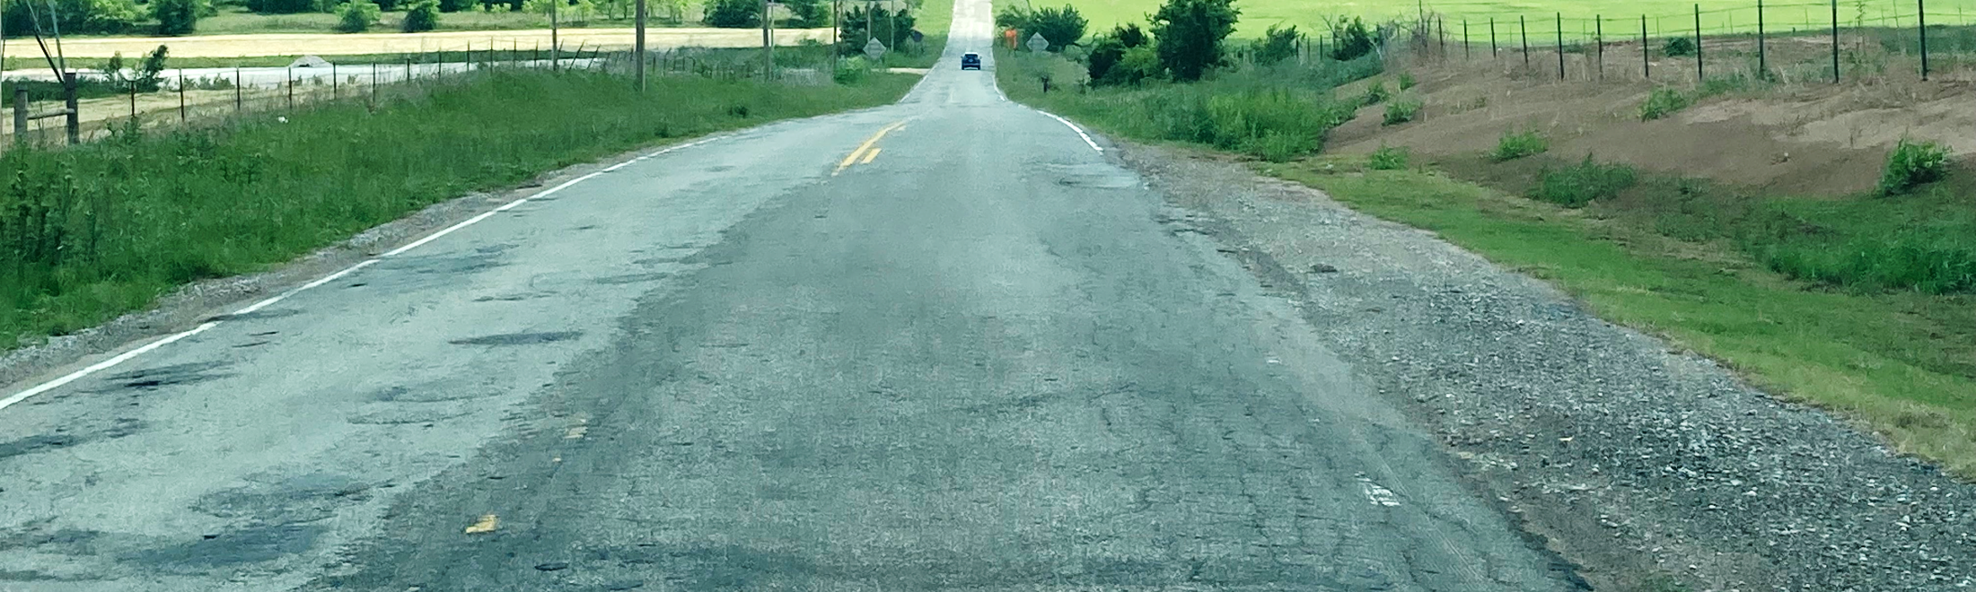
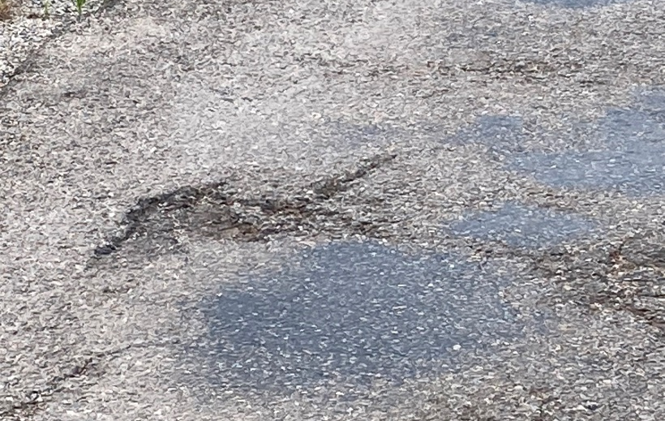
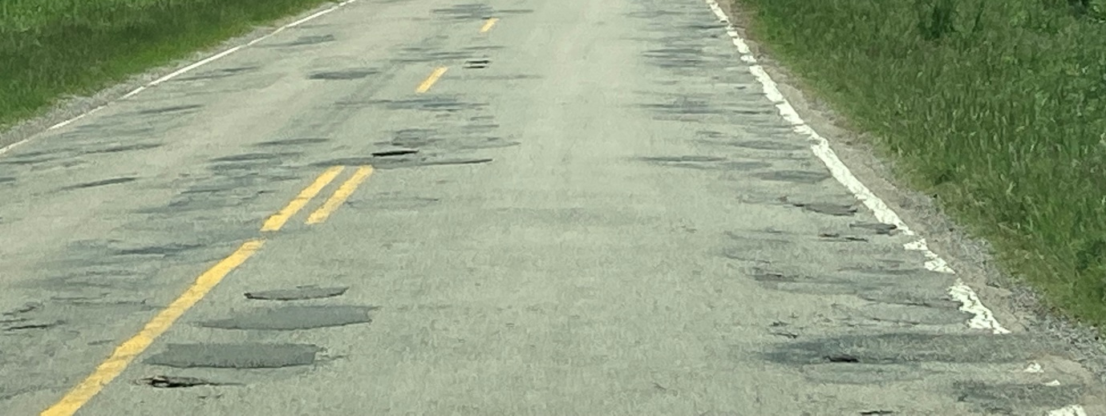
Wilshire Road, East of Hwy 4

Slide 9
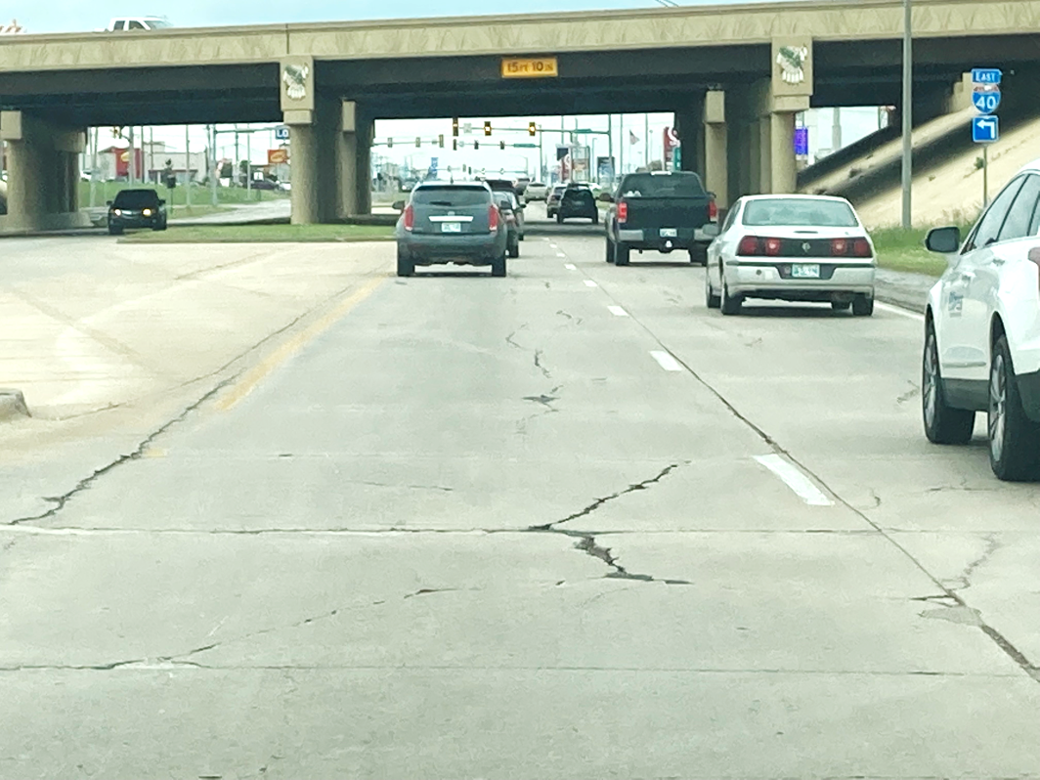
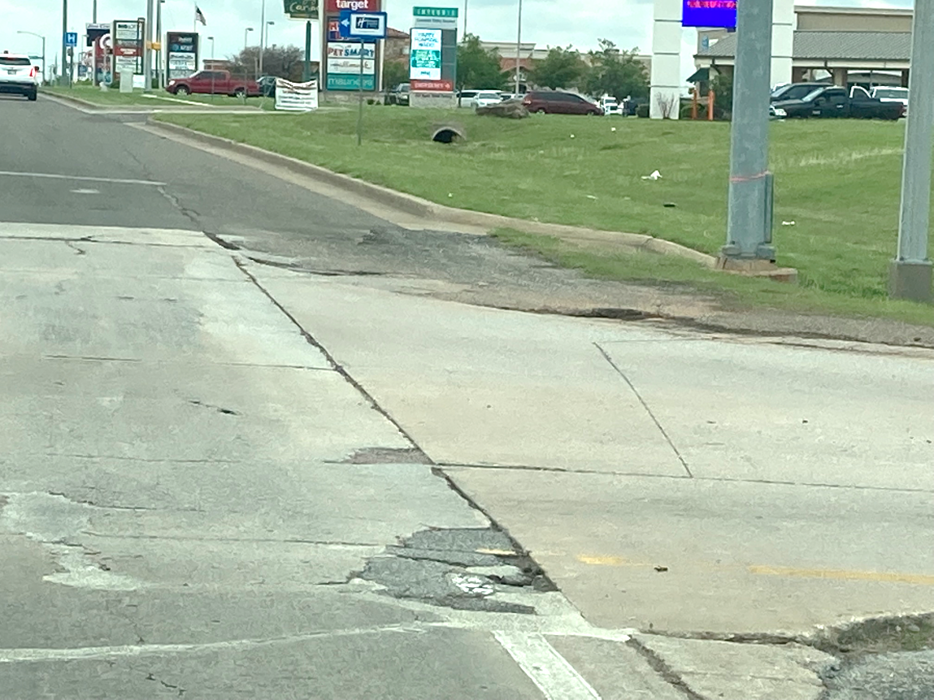
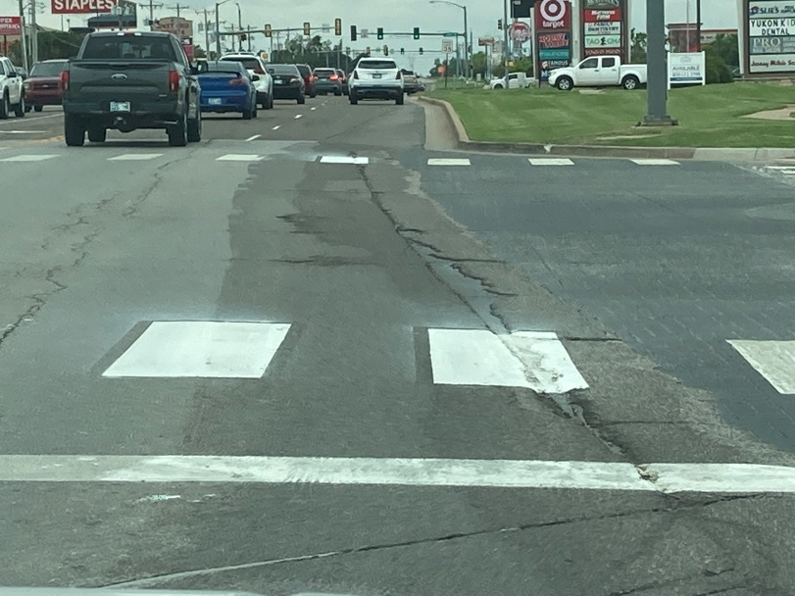
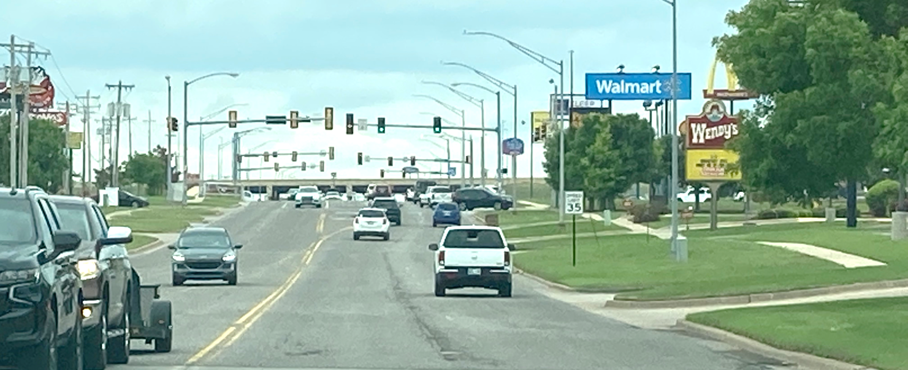
Garth Brooks Boulevard

Slide 10
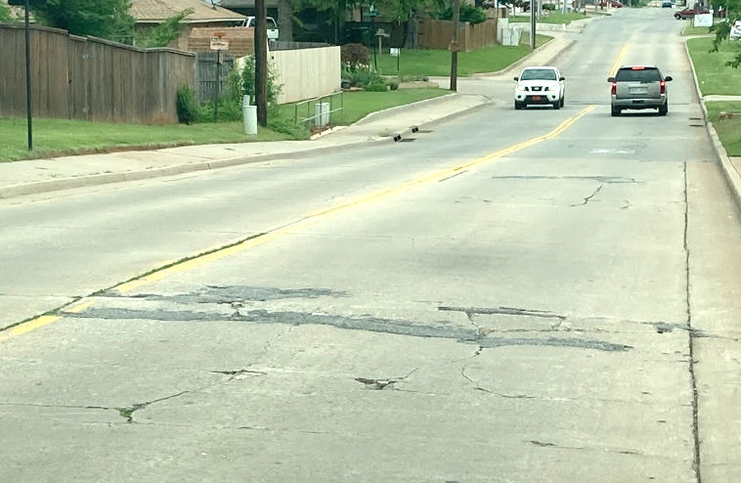
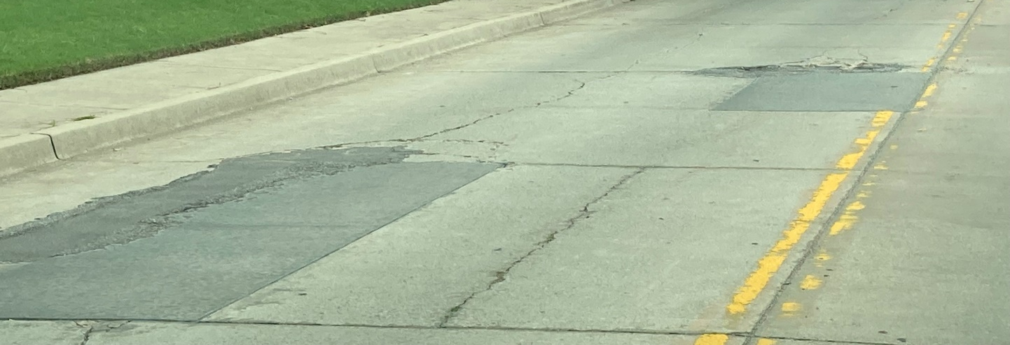
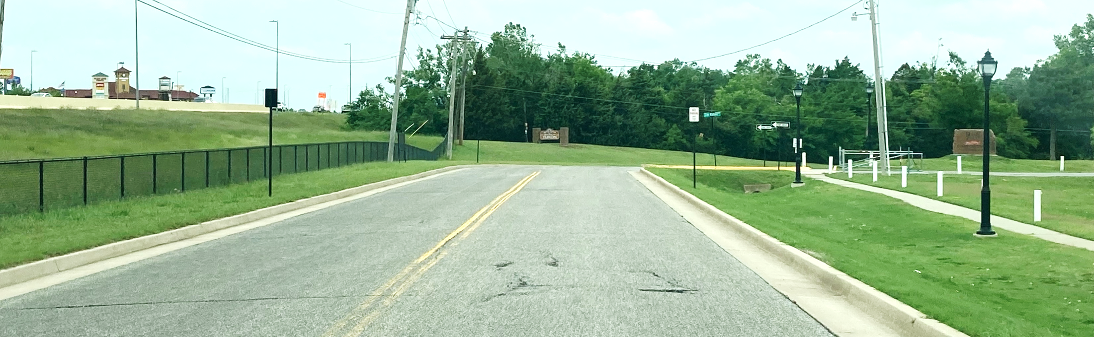
Holly Ave.

Slide 11
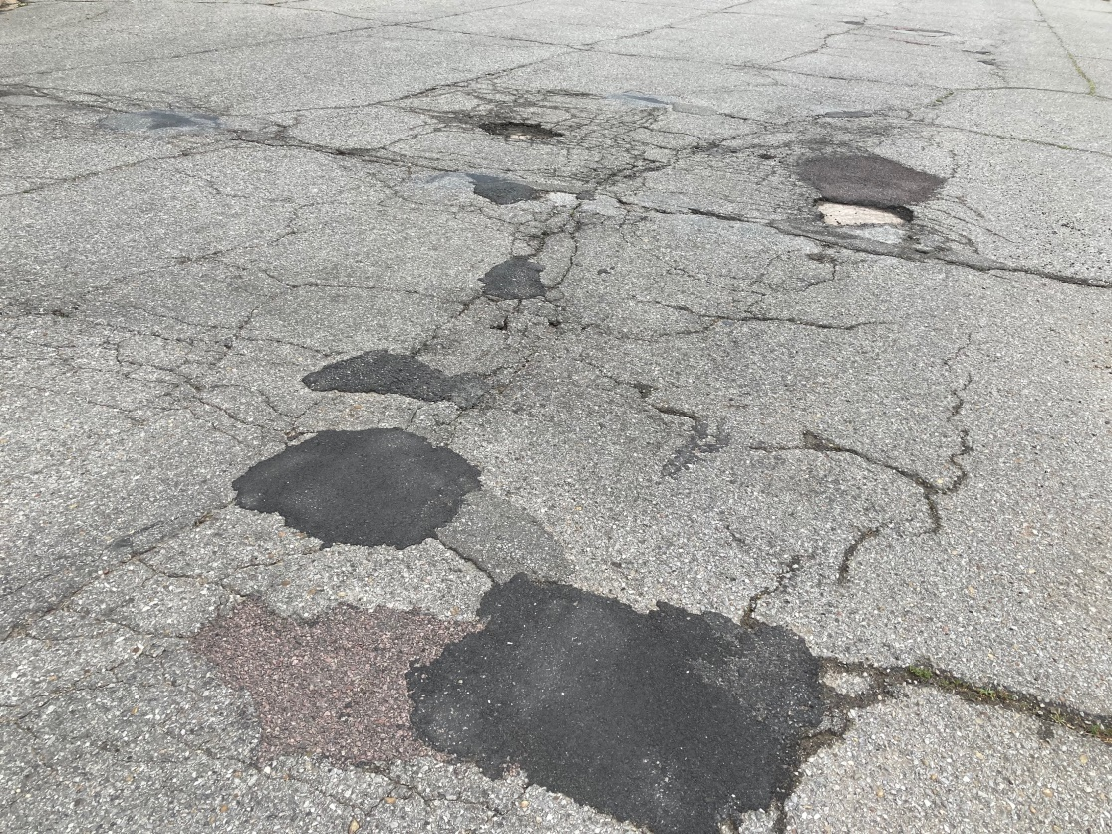
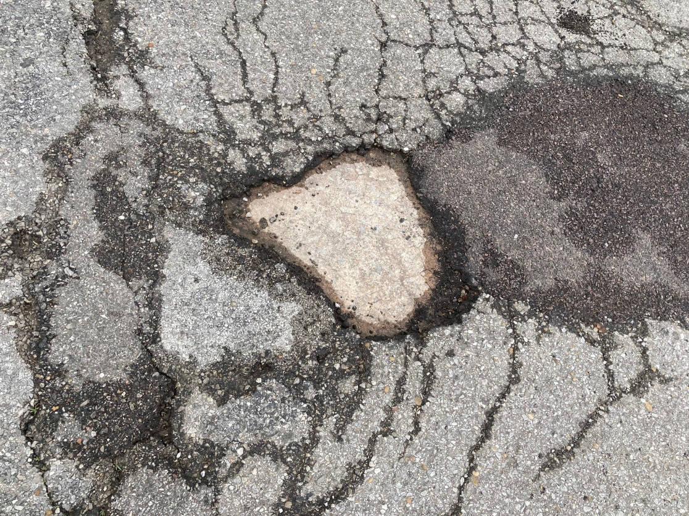
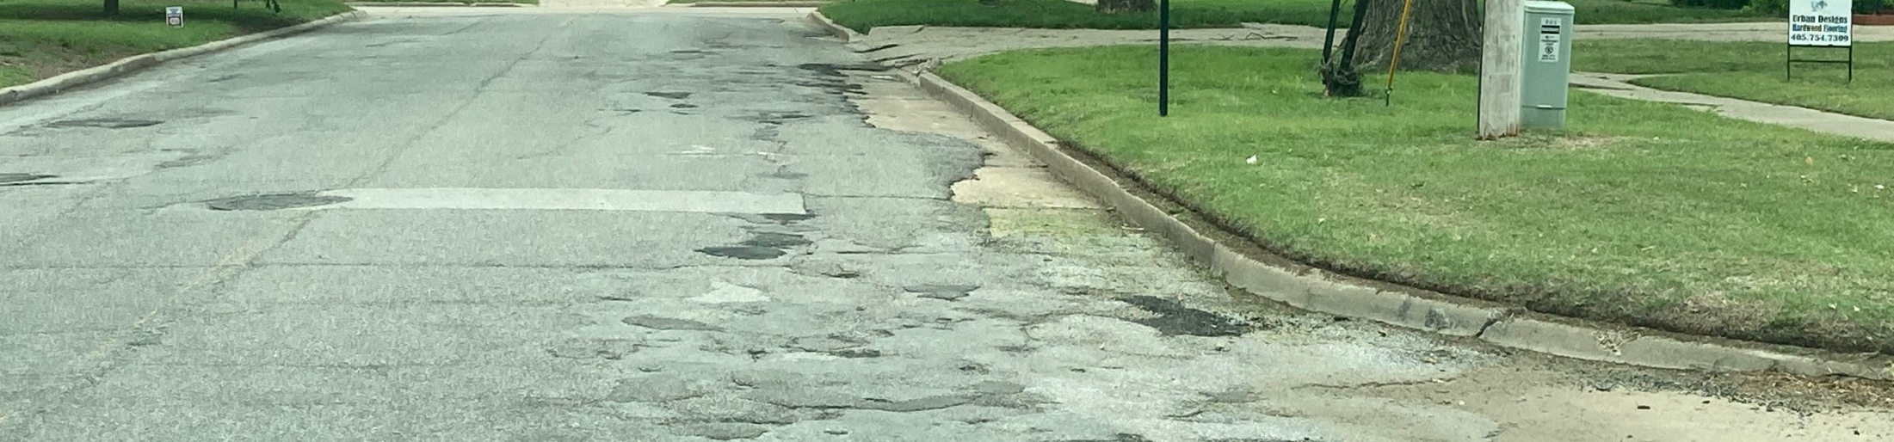
5th Street

Slide 12
Street Revitalization Features
Drainage
Trees (Trimming)
Signage
Sidewalks
Engineering

Slide 13
Current Capital Street Projects
Project ID | Street | Location | Opinion of Cost | Scope | Roadway
1 | 1st | Oak Ave to Vandament | $2,150,000 | Reconstruct Roadway (26') and Sidewalk | 6" Concrete
2 | Wagner Road | Yukon Parkway to Sara Rd | $3,000,000 | Reconstruct Roadway (28') | 8" Concrete
3 | Frisco Road | I-40 South to City Limits | $3,100,000 | Reconstruct Roadway (52') | 9" Concrete
4 | Spruce Dr | Cornwell Ave to Bass Ave | $1,450,000 | Reconstruct Roadway (26') and Sidewalk | 6" Concrete
5 | Holly Ave | Poplar Ave to NW 10th St | $1,070,000 | 2" Asphalt Overlay, 25% of 6" Concrete Panel Replacement
6 | 3rd St | Main St to Oak Ave | $480,000 | Reconstruct Roadway (26') and Sidewalk | 6" Concrete
7 | Kingston Dr | Holly Ave to Kingston Place | $230,000 | 25% of 6" Concrete Panel Replacement | 6" Concrete
8 | Garth Brooks | Main St to Vandament Ave | $1,000,000 | 2" Mill and Overlay
9 | Yukon Parkway | SH66 to Wagner Road | $8,000,000 | Reconstruct Roadway (52') and 1 Mile new 12" Waterline | 8" Concrete
10 | 4th St | Main St. to Oak Ave | $460,000 | Reconstruct Roadway (26') and Sidewalk | 6" Concrete
11 | 5th St | Main St to Poplar Ave | $620,000 | Reconstruct Roadway (26') and Sidewalk | 6" Concrete
12 | 3rd St | Poplar Ave to Yukon Ave | $530,000 | Reconstruct Roadway (26') and Sidewalk | 6" Concrete
13 | Richland Rd | Sunshire / South of Bridge | $260,000 | Roadway Replacement Near River Bridge and Sunshine Rd | 6" Asphalt
14 | Wilshire | Highway 4 to Sara Rd. | $3,800,000 | Reconstruct Roadway (28') | 8" Asphalt
15 | Vandament | Redbud Ave Intersection | $200,000 | Concrete Panel Replacement | 6" and 9" (Vandament
 |  | Total Opinion of Cost | $26,350,000

Slide 14
Questions?

