Slide 1
Community Impact of
Parks and Recreation Facilities

Slide 2
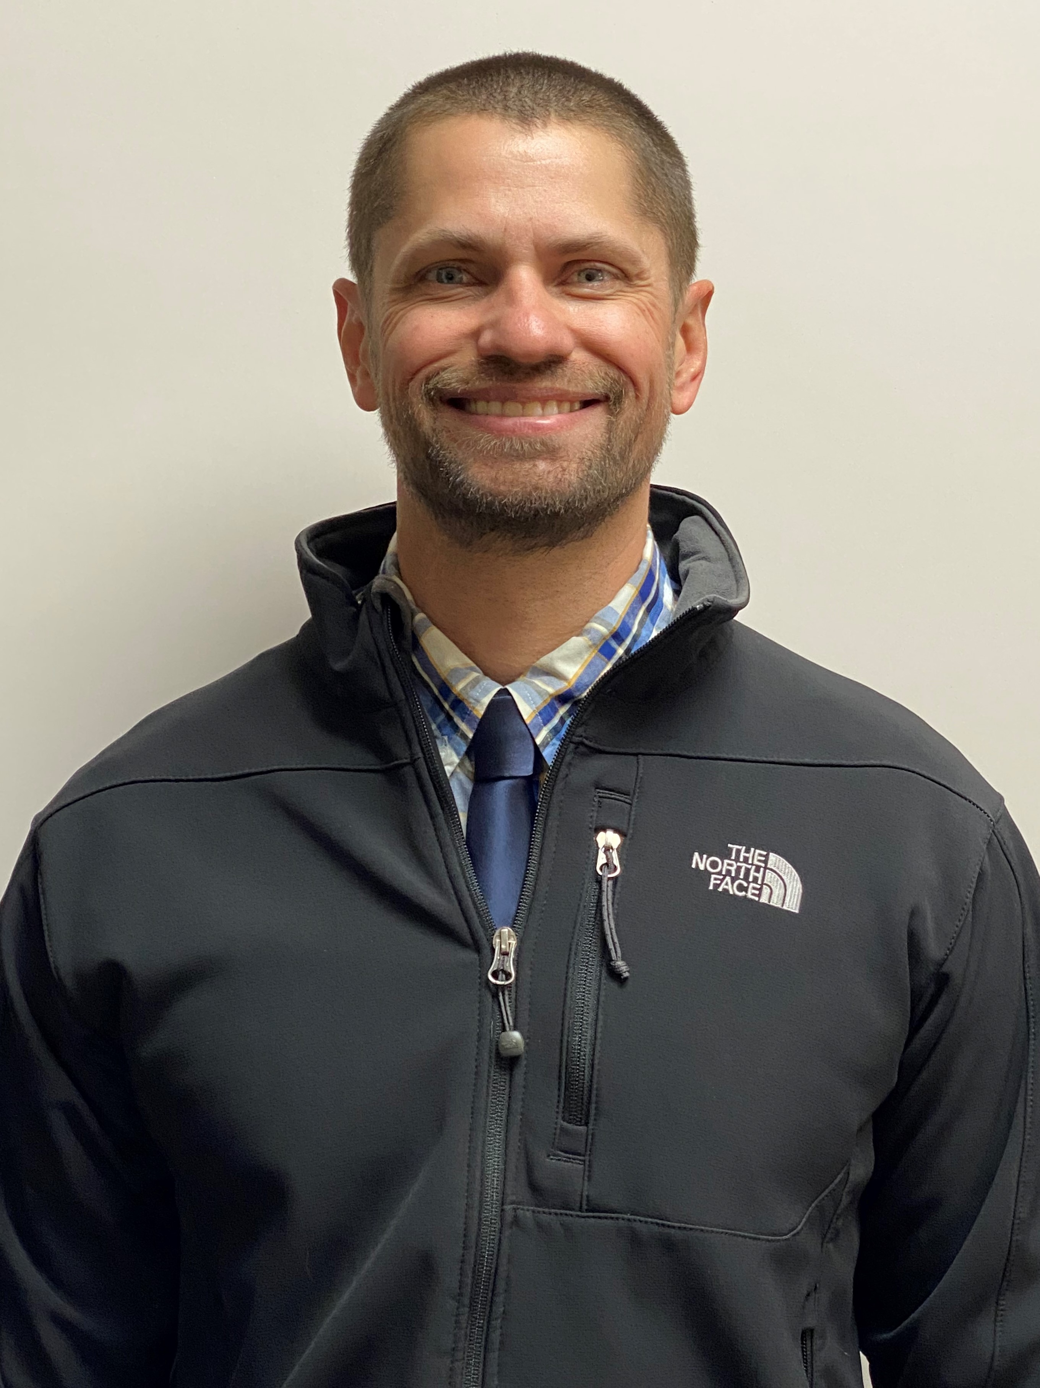
Introduction
 | Chris Lucas, CPRP Parks and Recreation Director

Slide 3

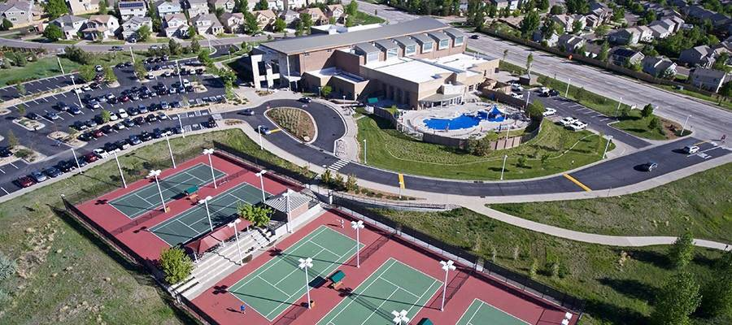
Professional Background

Slide 4
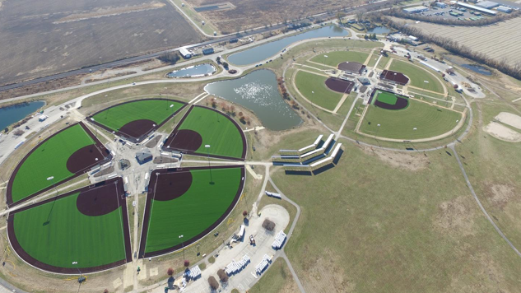
Professional Background

Slide 5
What will be discussed?
Economic Impact of Parks and Recreation
City Yukon of Sample Pro Forma
Facility Optimization Strategy
8-Diamond Sports Complex
Multi-generational Recreation Facility
Conclusion/Questions
How Does this Relate to Yukon?

Slide 6
Economic Impact
 | Global (2017) | Oklahoma (2017)
Economic Activity (transactions) | $ 166.37 billion | $ 1.97 billion
Value Added (GDP) | $ 87.03 billion
Labor Income (salaries, wages, benefits) | $ 50.78 billion | $ 556.17 million
Employment (jobs) | 1,125,640 jobs | 12,941 jobs

Slide 7
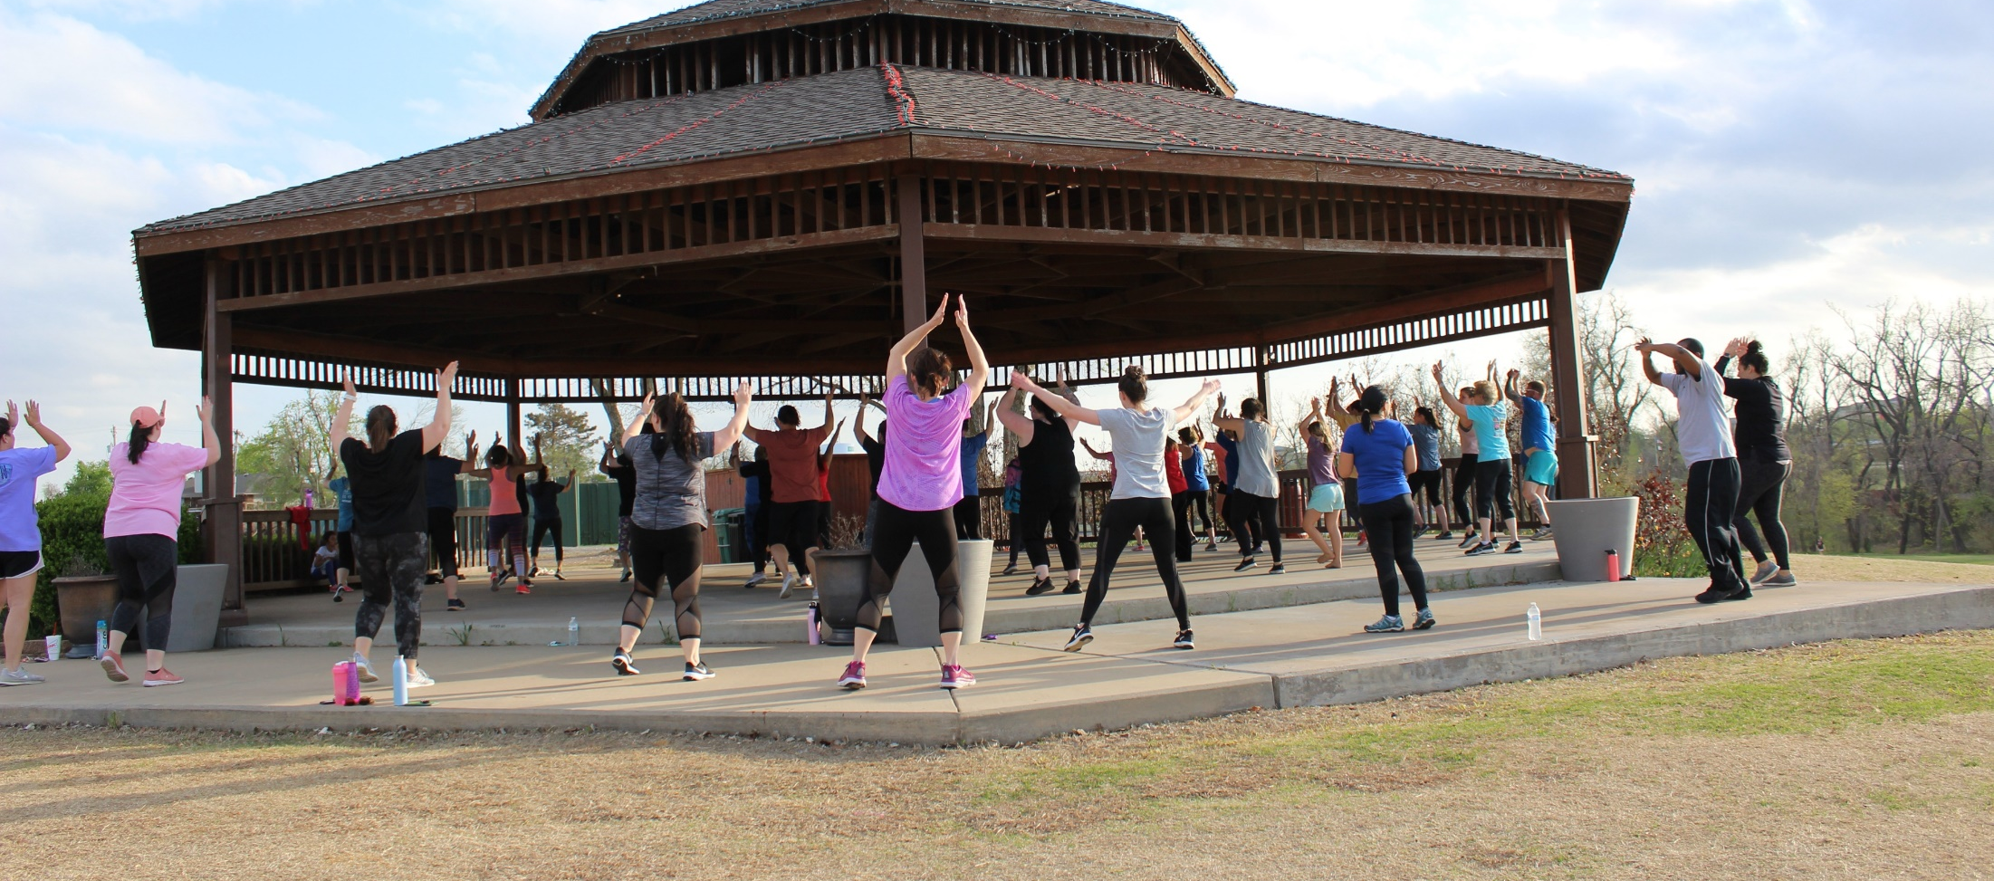
Other Critical Economic Impact from Public Parks include:
Health and Wellness

Slide 8
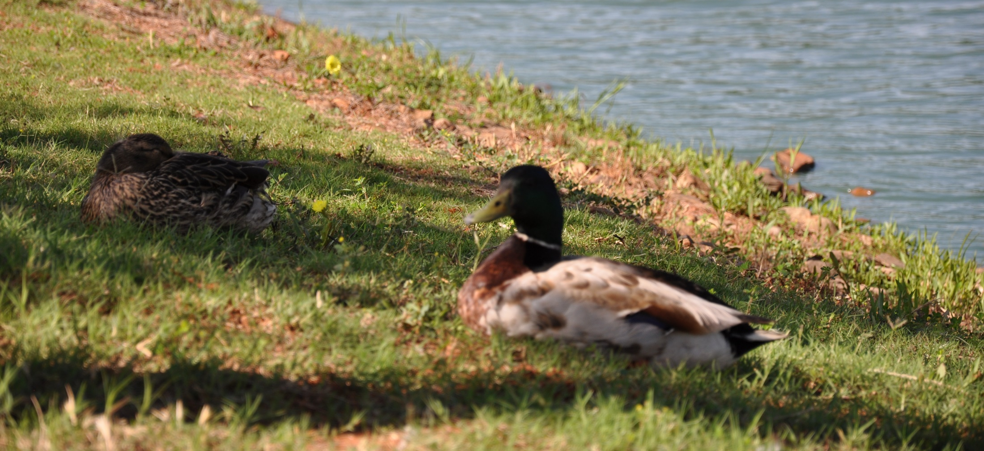
Other Critical Economic Impact from Public Parks include:
Conservation and Resiliency

Slide 9
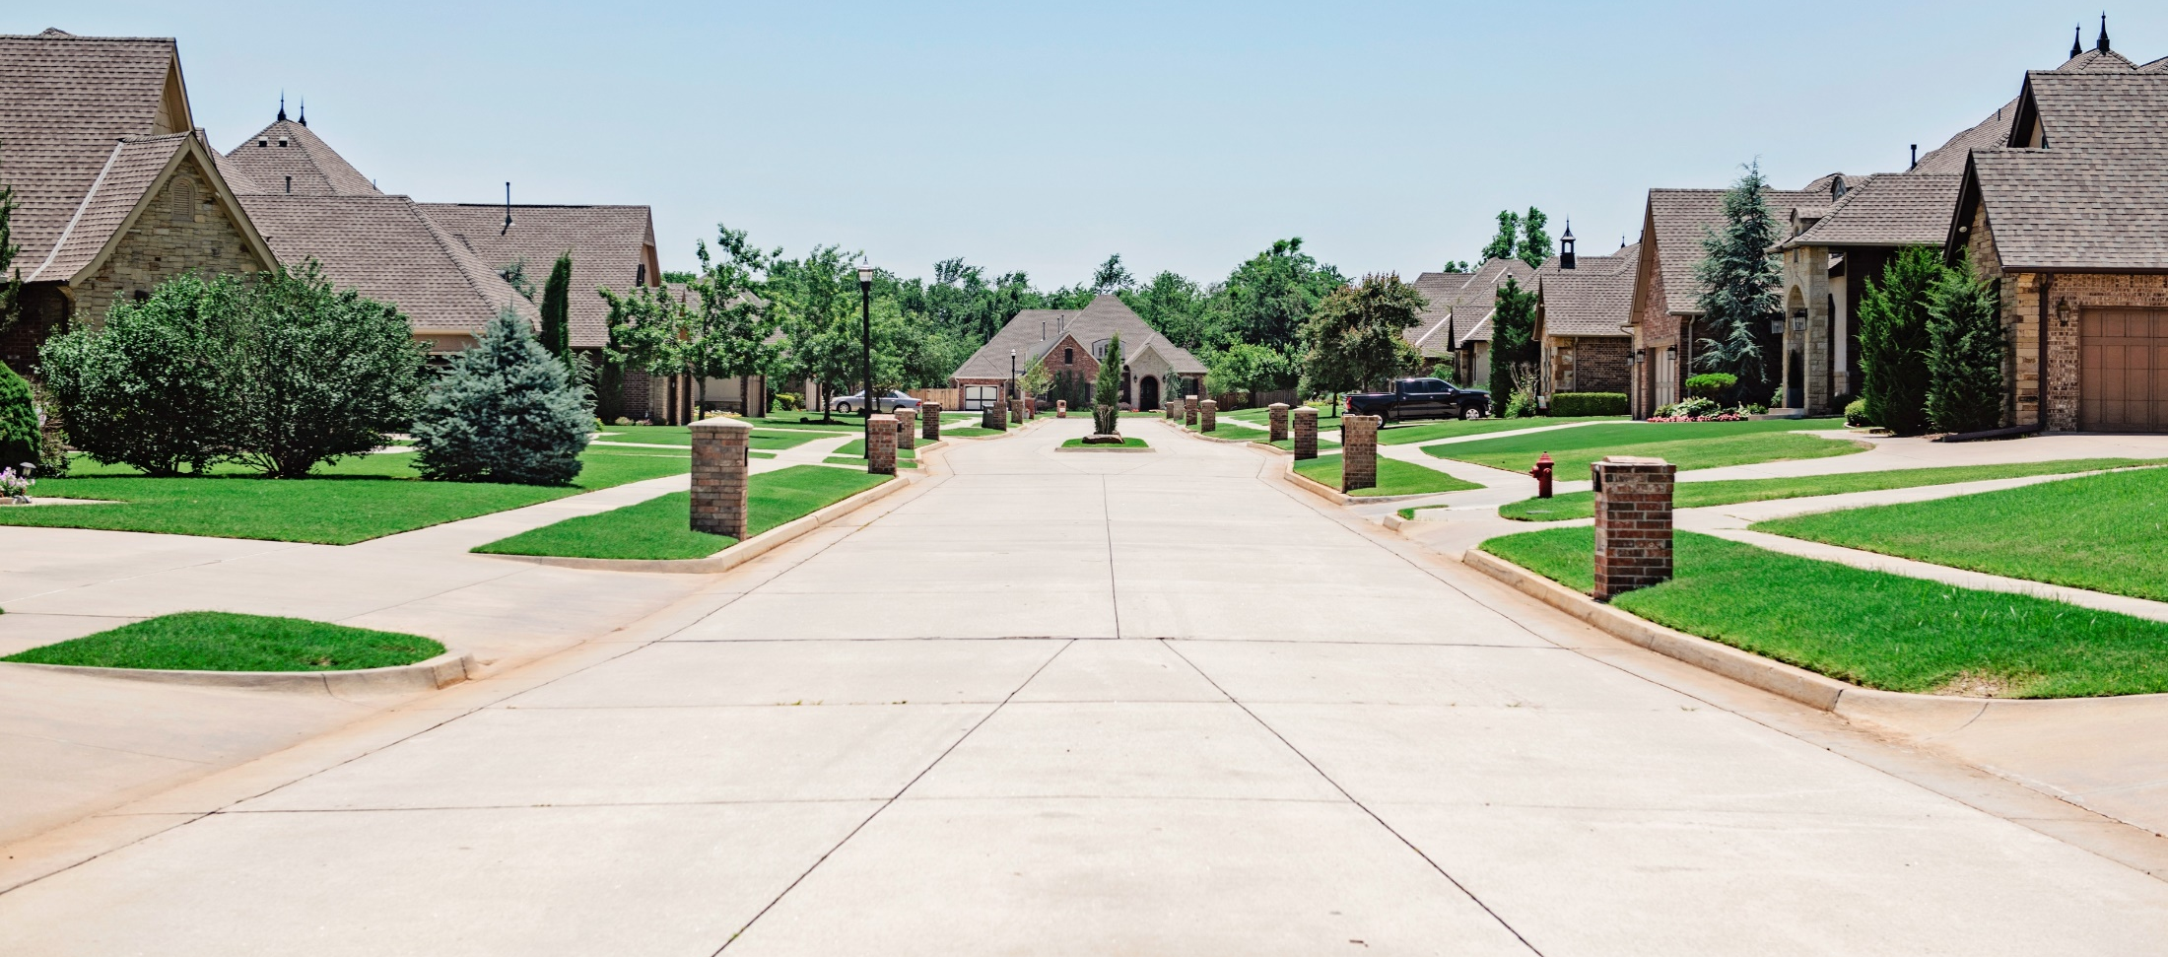
Other Critical Economic Impact from Public Parks include:
Property Values

Slide 10
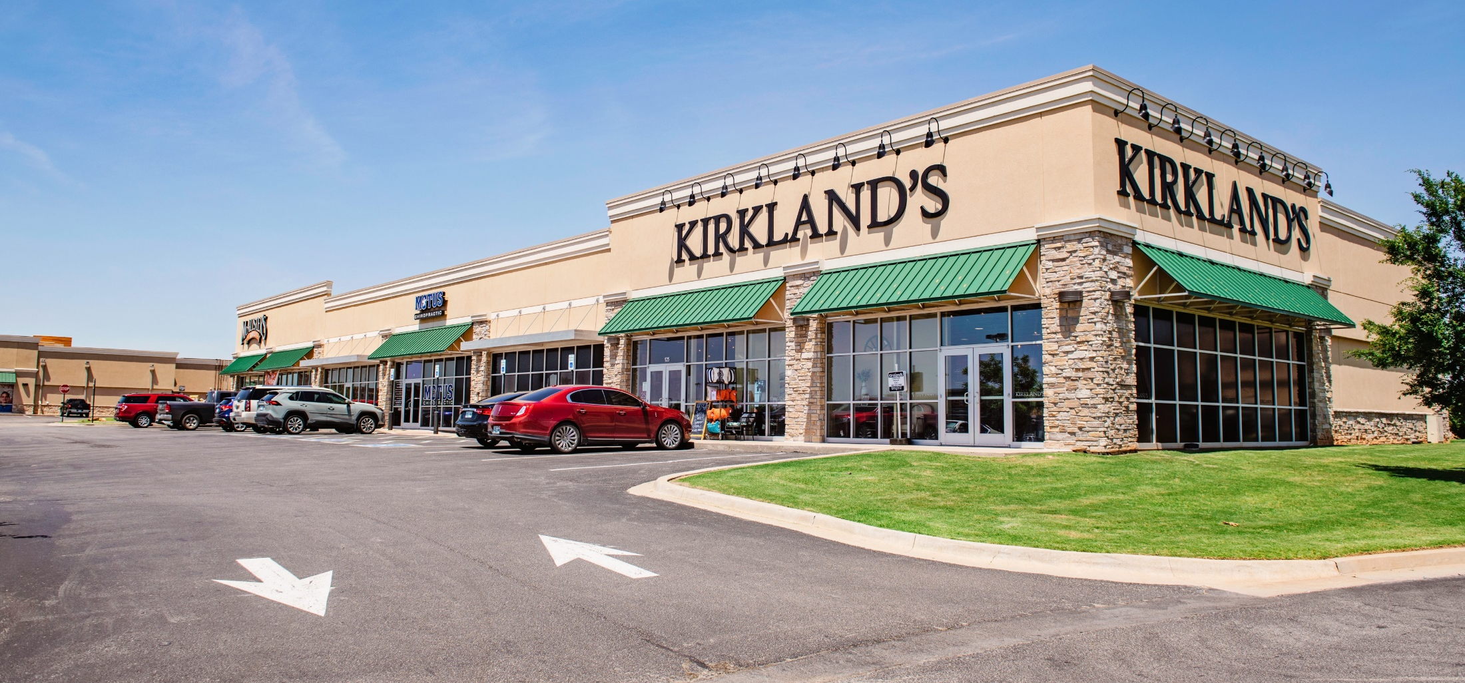
Other Critical Economic Impact from Public Parks include:
Visitor Spending

Slide 11
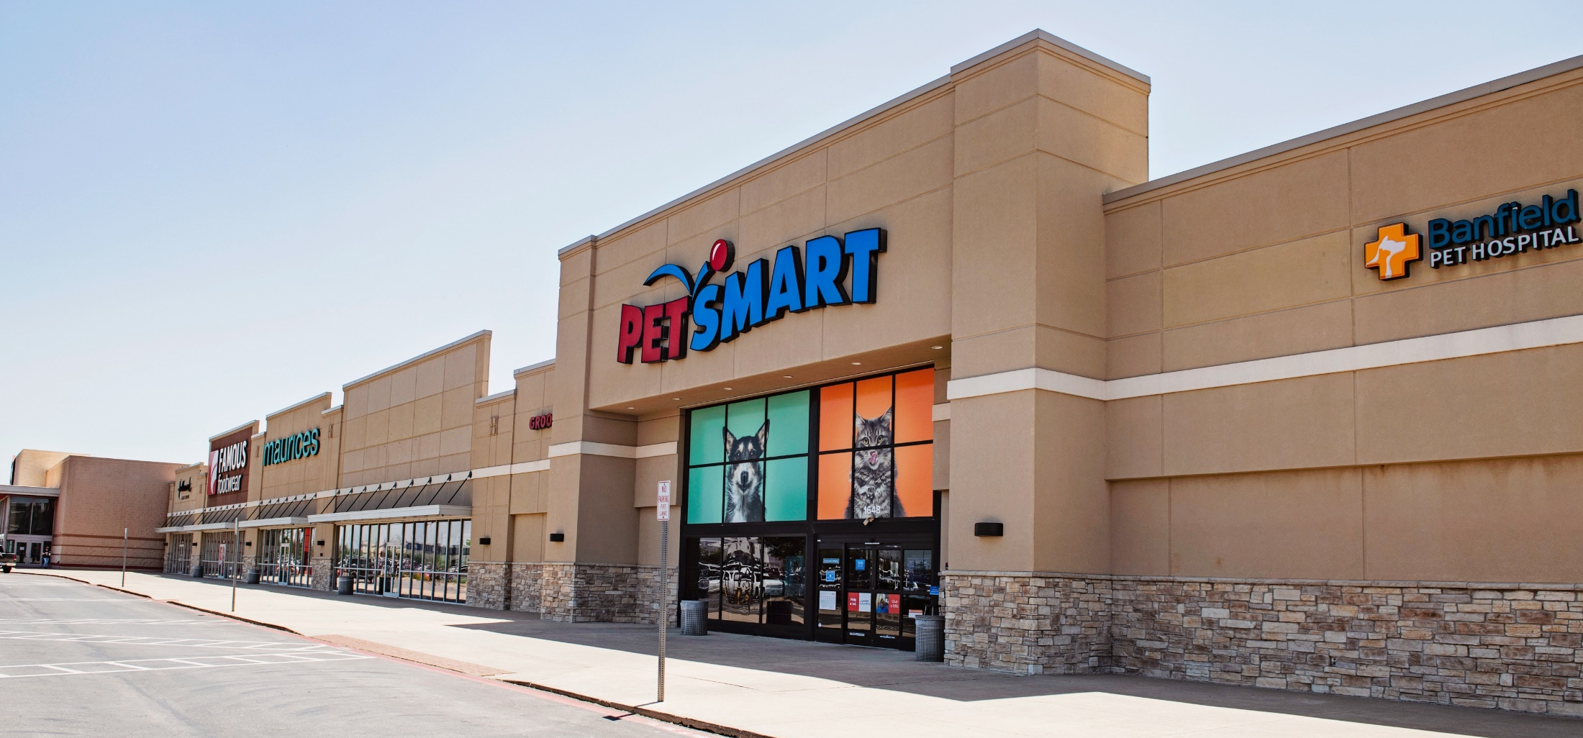
Other Critical Economic Impact from Public Parks include:
Economic Development

Slide 12
How Does this Relate to Yukon?
2021 Citizen Survey Results
Development of Property at Frisco Rd/Hwy 66

Slide 13
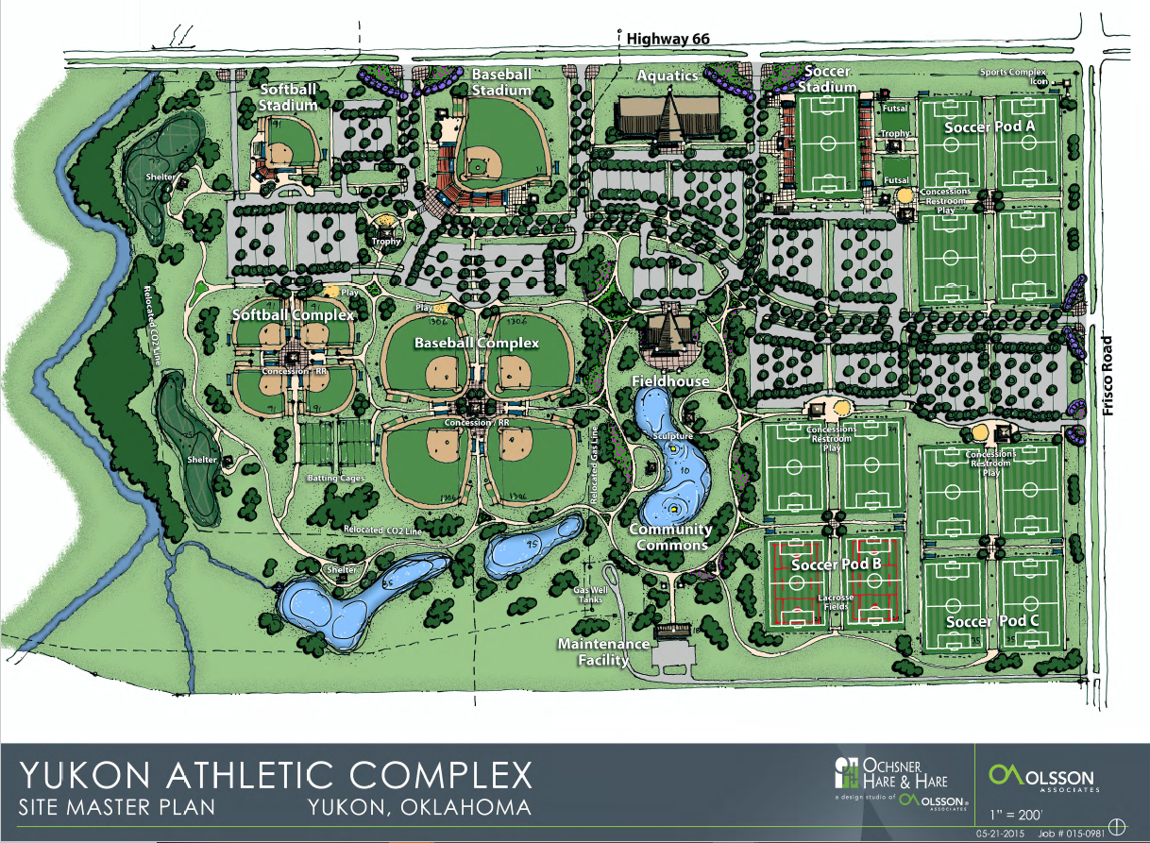
Yukon Athletic Complex –
2015 Master Plan

Slide 14
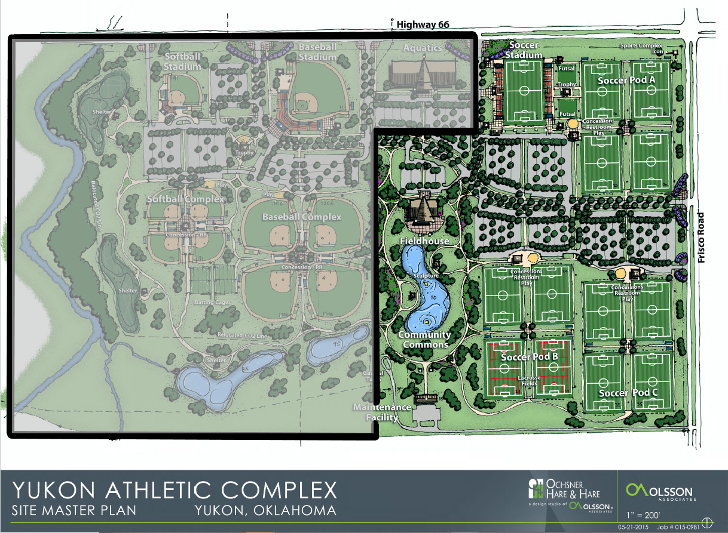
Yukon Athletic Complex –
2015 Phase 1

Slide 15
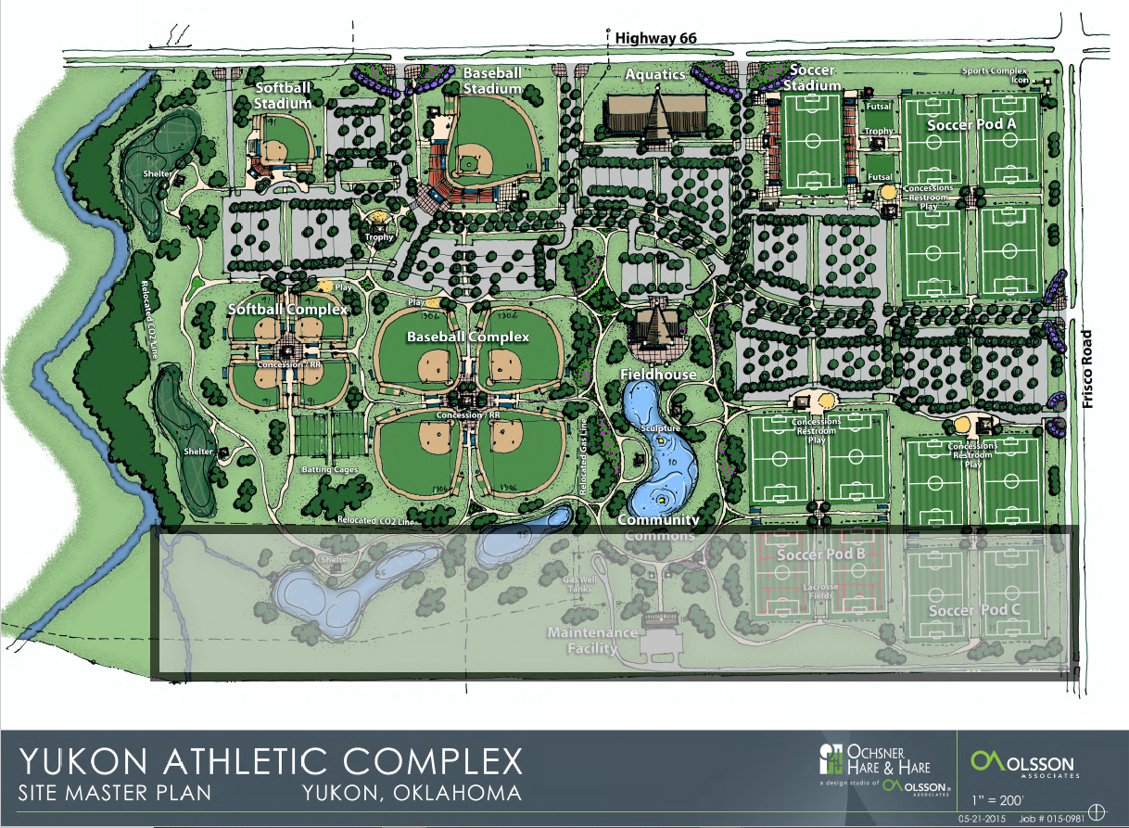
Yukon Athletic Complex –
Sold Property

Slide 16
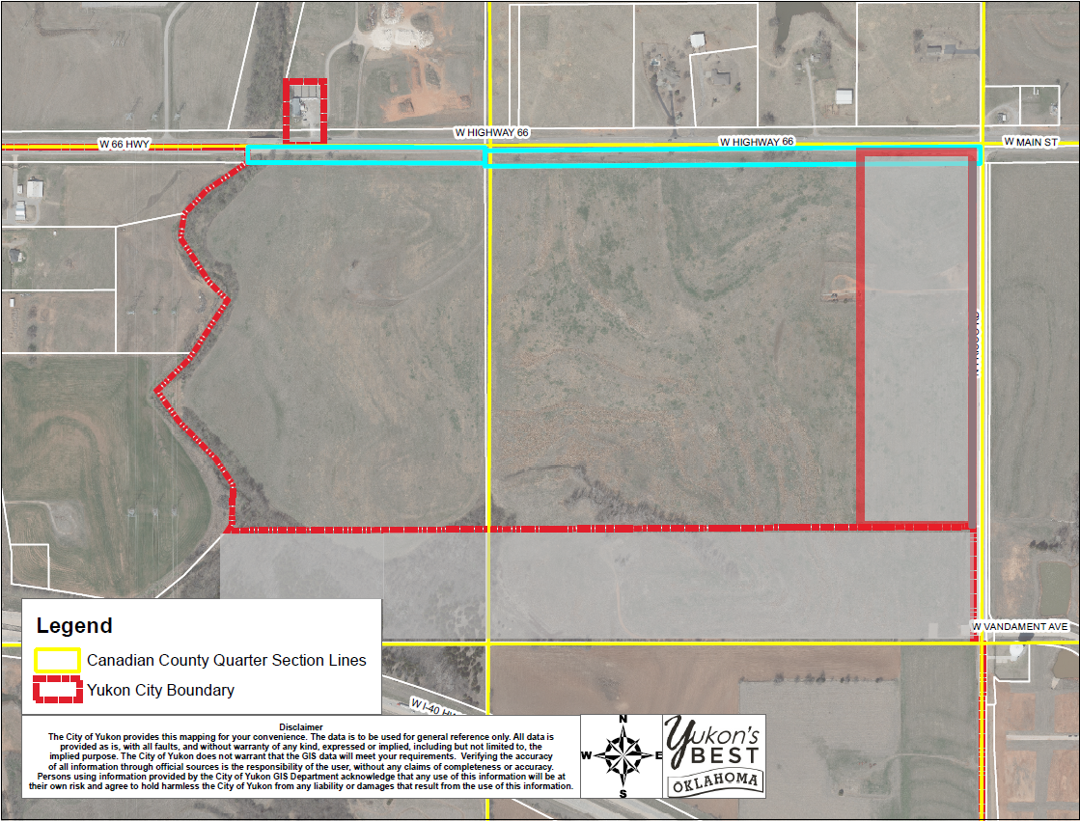
Frisco Rd./Hwy 66 Property –
Usable Space (184 Acres)

Slide 17
City Yukon of Sample Pro Forma
8-Diamond Sports Complex Handout
Multi-generational Recreation Facility Handout

Slide 18

PLANNING
DEVELOPMENT
MANAGEMENT
OPTIMIZATION

Slide 19
Planning
Existing Community Inventory
Vision Casting, Strategic Planning
Market Opportunity Analysis
Financial Modeling
Master Planning

Slide 20
Development
Partner Development
Venue Planning for Effectiveness
Architectural Design Process
Construction

Slide 21
Management
Pre-Opening Booking, Sales
Operational Set-Up
Team Development

Slide 22
Optimization
Exceed Expectations
Guest Experience
Spur Economic Growth & Development
Economic Impact
Financial Performance
Community Use

Slide 23
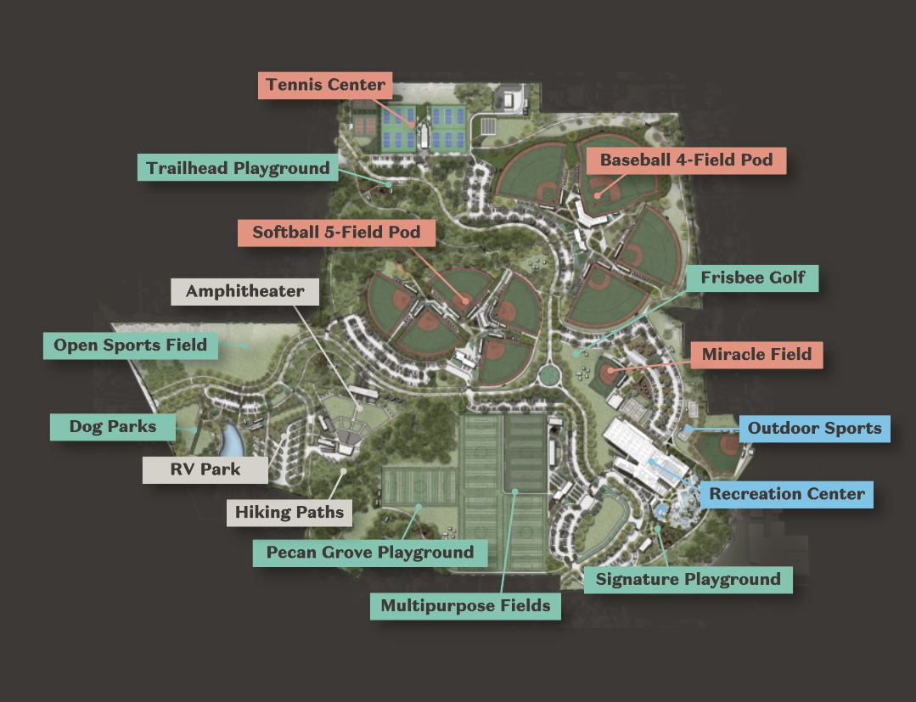
Can it be Done?
Sand Mountain Park and Amphitheater – Sand Mountain, AL

Slide 24
Conclusion / Questions

